Slide 1
Proof-of-work (POW) :
Proof-of-Work Properties
The proof-of-work function of an hash puzzle must be:
1.Difficult to compute
2. The difficulty is parameterizable
3. It’s trivial to verify the new node has computed proof-of-work correctly

Slide 2
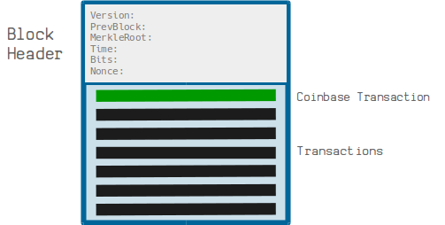
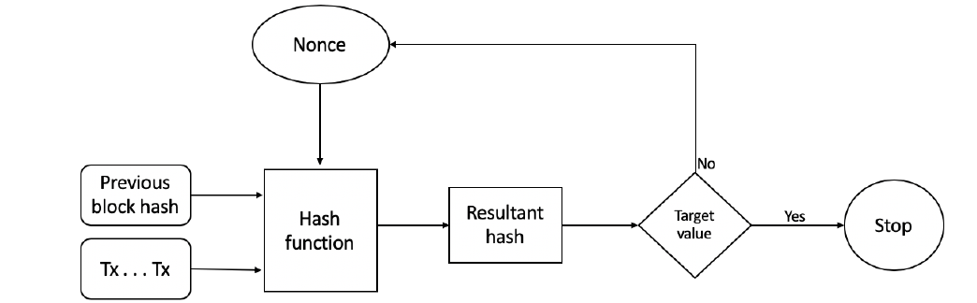
Proof-of-work (POW) :

Slide 3
Proof-of-work :
POW works as follows:
POW makes use of hash puzzles
A node proposes a block has to find a nonce such that H(H(version || previous Block hash || MerkleRoot||Timestamp|| Difficulty target||nonce) < Difficulty Target value
The process can be summarized as:
New transactions are broadcast to all nodes on the network
Each node collects the transactions into a candidate block
Miners propose new blocks
Miners concatenate and hash with the header of the previous block
The resultant has is checked against the target value (network difficulty target value)
If the resultant hash is less than the target value then POW is solved. Otherwise the nonce is incremented and the node tries again. This process continues until a resultant hash is found that is less than target value.

Slide 4
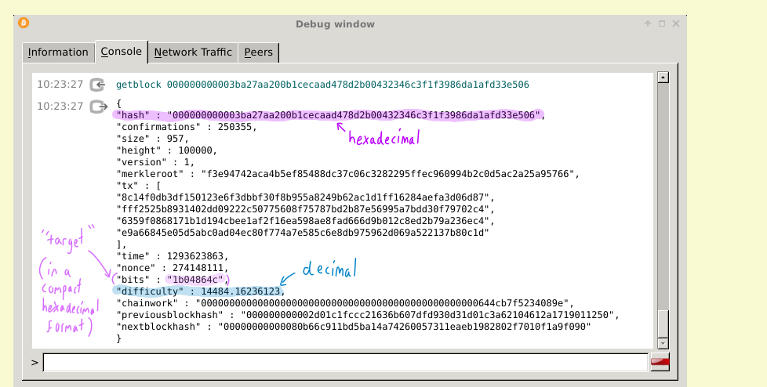
What do the zeros in cryptocurrency mean?
The number of zeros in hash is not fixed. As more miners join the pool, chances of finding the number quickly increases. So Bitcoin can choose to increase the number of zero, which increases the difficulty. The difficulty is maintained in such a way that the average time to add a new block is 10 mins.
Example Calculation
Suppose Bitcoin's difficulty is set such that valid hashes must be less than:00000000FFFFFFFFFFFFFFFFFFFFFFFFFFFFFFFFFFFFFFFFFFFFFFFFFFFFFFFF
Any hash value below this target must start with at least 8 leading zeros.
More leading zeros mean higher difficulty and more computational effort
Higher Difficulty → Smaller Target → More Leading Zeros Required

Slide 5
Suppose the difficulty target is:
00000000FFFFFFFFFFFFFFFFFFFFFFFFFFFFFFFFFFFFFFFFFFFFFFFFFFFFFFFF
A valid hash must be smaller than this.Hashes that start with more 0s are smaller in value.
If difficulty is low, a hash like:
00A98CDE4567ABCDEF1234567890ABCDE1234567890ABCDEF1234567890ABCDEFmight be valid.
If difficulty is high, only a hash like:
000000000B98CDE4567ABCDEF1234567890ABCDE1234567890ABCDEF1234567890
will be accepted.

Slide 6
Example
Hashes While Mining The miner changes the nonce and recalculates the hash until it meets the difficulty target.
Nonce Computed Hash
0 3f8a4b6c4d92ffcd9ab1e3549e7e654b12345678abcd1234
9ac1b765a2f3d99cb0d9823edcba98765432abcd12345678
0058a9b7c234cd92ffcd9ab1e3549e7e654b12345678abcd ✅ (Valid)

Slide 7
Setting the mining difficulty
Every two weeks, compute:
New_difficulty= previous_difficulty * (t/2 weeks)
New_difficulty= previous_difficulty *(time to mine last
2016 blocks/12,09,600 seconds)
Expected number of blocks in 2 weeks at 10 minutes/block

Slide 8
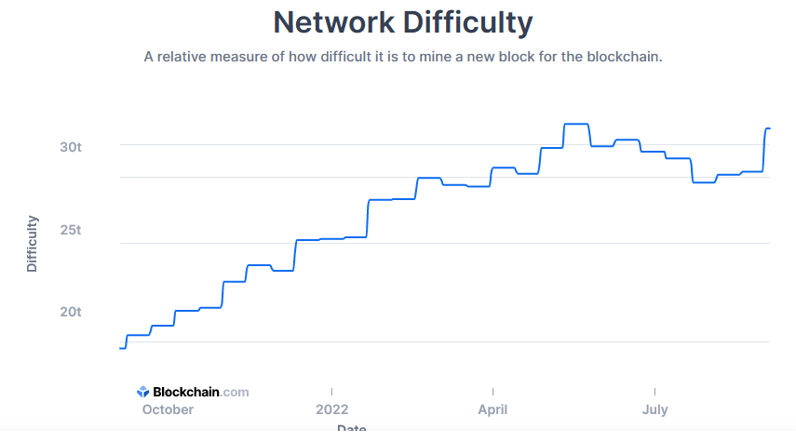
Mining difficulty over time
https://www.blockchain.com/charts/difficulty

Slide 9
Time to find a block
https://bitinfocharts.com/comparison/bitcoin-confirmationtime.html?utm_source=chatgpt.com#3y
To find Bitcoin Netwrok hashrate https://ycharts.com/indicators/bitcoin_network_hash_rate?utm_source=chatgpt.com
Bitcoin Average Confirmation Time
https://ycharts.com/indicators/bitcoin_average_confirmation_time?utm_source=chatgpt.com
To find Hash rate:
https://www.blockchain.com/explorer/charts/hash-rate?utm_source=chatgpt.com
To find difficult
https://www.blockchain.com/explorer/charts/difficulty

Slide 10
Hash Rate = (Blocks Found / Blocks Expected) * (current Difficulty * 2^32) / 600
Let’us takean example over a 12-hour period.
In 12 hours we would expect 72 blocks to be found at a rate of one every ten minutes, but only 65 are found. And, the current difficulty is 24,272,331,996,979. So,
Hash Rate = (65/72) * (24,272,331,996,979 * 2^32) / 600 =
0.90 * 104,248,870,000,000,000,000,000 / 600 = 1.5685594e+20 H/s
And we convert units,
156,855,940,000,000,000,000 H/s / 1,000,000,000,000,000,000 H/s =
12h Hash Rate = 157 EH/s

Slide 11
Summary:
What is the difficulty?
The difficulty is a number that regulates how long it takes for miners to add new blocks of transactions to the blockchain
Why is the difficulty important?
Because it ensures that blocks of transactions are added to the blockchain at regular intervals, even as more miners join the network.
If the difficulty remained the same, it would take less time between adding new blocks to the blockchain as new miners join the network.
When does the difficulty change?
The difficulty adjusts every 2016 blocks (roughly every 2 weeks)
Network’s hash rate is not accurate at any given instance

Slide 12
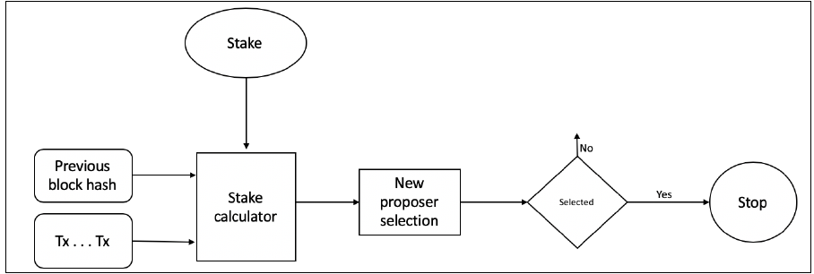
How PoS(Proof of Stake) works?

Slide 13
Energy consumption & ecology

Slide 14
Thermodynamic limits
Landauer’s principle: Any non-reversible computation must consume a minimum amount of energy.
Specifically, each bit changed requires (kT ln 2) joules
SHA-256 is not reversible
Energy consumption is inevitable

Slide 15
Why does Bitcoin mining require energy? Energy aspects of Bitcoin mining
Embodied energy: used to manufacture mining chips & other equipment
should decrease over time
returns to scale
Electricity: used to perform computation
should increase over time
returns to scale
Cooling: required to protect equipment
costs more with increased scale!

Slide 16
Energy consumption estimation:
Strategy with Upper bound and Lower bouns

Slide 17
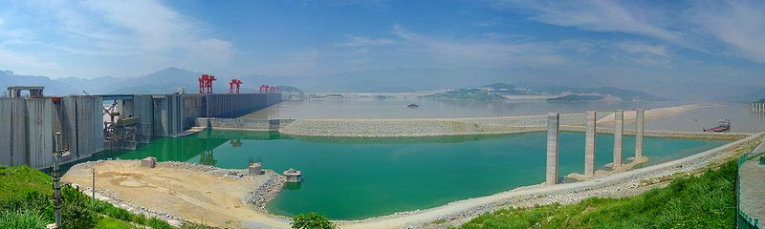
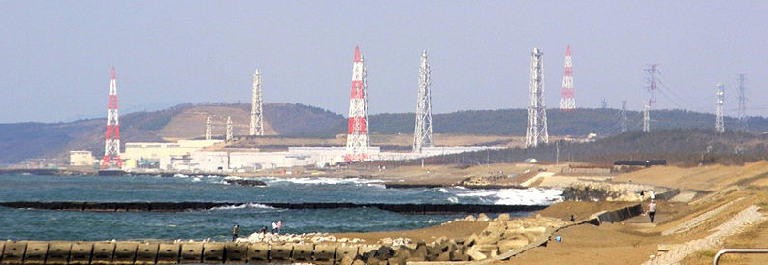
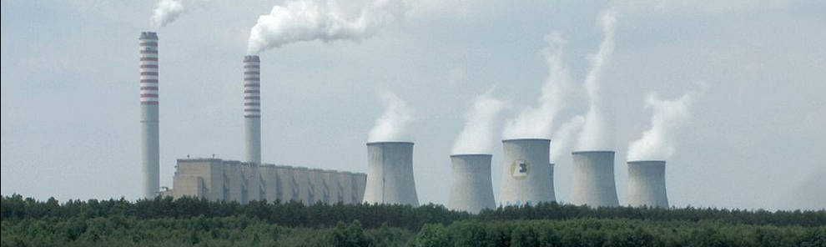
Three Gorges Dam = 10,000 MW
typical hydro plant ≈ 1,000 MW
Kashiwazaki-Kariwa
nuclear power plant = 7,000 MW
typical nuclear plant ≈ 4,000 MW
major coal-fired plant ≈ 2,000 MW
The whole Bitcoin network, even considering the upper bound counsumes less than 1000MW. So, we need to run a big electricity power plant purely to power Bitcoin.

Slide 18

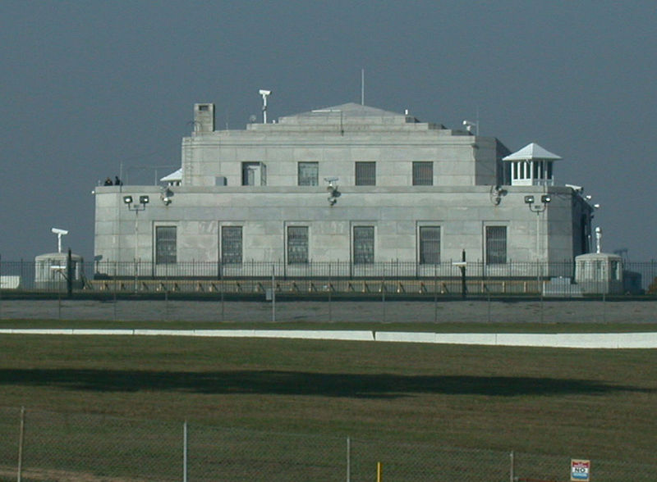
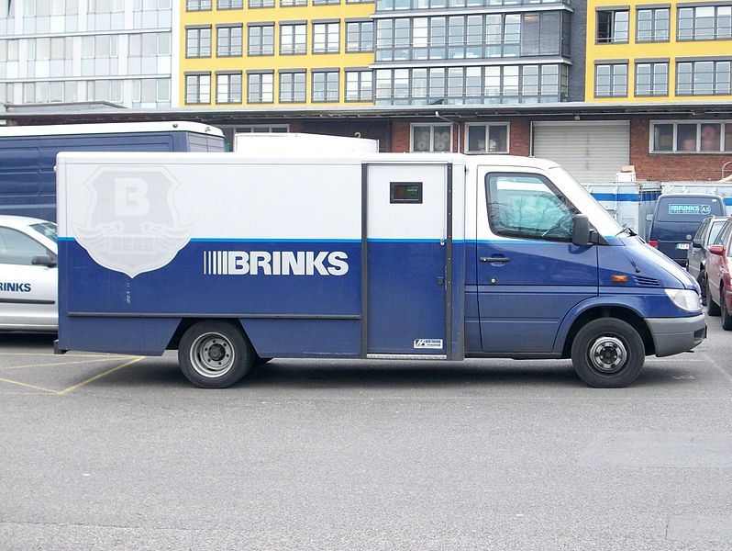
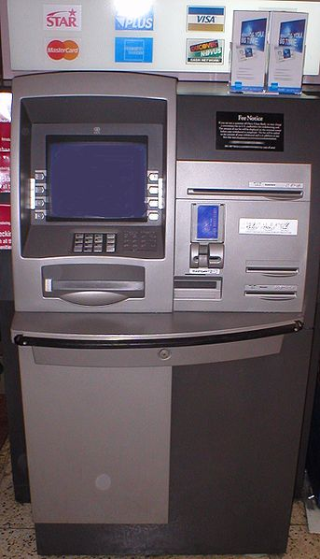
Comparison with other kind of consumption:
To understand where it's a big amount or not we need to compare it to other things in the world. For example, any payment system is going to require energy and electricity. So we can look at traditional currency. Energy is consumed to:
producing the money
transporting the money aroundin armored cars
guarding money
running the ATM machines and cash registers
Even all this energy, doesn't serve any other purpose besides maintaining the currency system. So that's a really important disclaimer, just because Bitcoin uses electricity, it's not necessarily wasted. If Bitcoin is a useful currency system then the electricity is essentially being used for that purpose.

Slide 19
Challenges in Bitcoin Mining
Electricity Theft in Mining
The Economics of Individual Mining

Slide 20
Data furnaces
Observation: in the limit, computing devices produce heat almost as well as electric heaters!
Why not install mining rigs as home heaters?
There are still some challenges to be cleared:
Electric heaters are still less efficient than gas heaters. So in very cold places, they won't be enough.
the ownership of mined Bitcoins. Will the Bicoins be property of the people who buy the appliance or of the company who sells them? Many people would have no interest in mining Bitcoins. So for them it would be better to buy the appliance at a lower cost and give the rewards to the company who sells them
This could have effect on Bitcoin production and network maintenance, since the production could lower in summer and in warmer days.e the rewards to the company who sells them.

Slide 21
Open ??
think about the questions that remain open for the future:
Will Bitcoin drive out electricity subsidies?
Will Bitcoin require guarding power outlets?
Especially around universities and corporations, large buildings with a lot of power outlets, will they need security cameras to make sure that employees or students aren't trying to mine Bitcoins by plugging into power outlets and just letting them run?
Is it possible to create a currency with no proof-of-work?

Slide 22
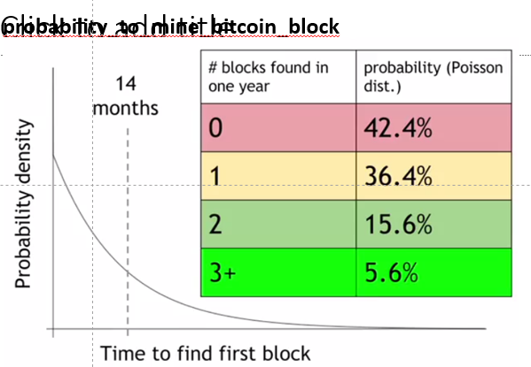
Mining Variance (Poisson Distribution)
Variance is high, making small-scale mining unsustainable.

Slide 23
Mining Variance (Poisson Distribution)
Finding a block is random, and follows a Poisson distribution, meaning:
- 40% chance of not finding any block in a year.
-36% chance of finding one block, barely covering costs.
-Small chance of finding 2+ blocks, leading to profit.
Variance is high, making small-scale mining unsustainable.

